Slide 2
Welcome to our presentation on Carrs Lane Counselling Centre
Celebrating 50 years of counselling care in Birmingham
1967 - 2017

Slide 3
“We are providing an oasis of calm in the heart of the city”

Slide 4
Who Are We? We are a counselling centre in the heart of Birmingham that is dedicated to providing a low-cost, first class counselling service to adults right across the wider West Midlands conurbation. We have been helping the people of our region for 50 years and we can assist with a diverse range of issues

Slide 5
What Do We Offer? We offer a range of therapy options such as individual counselling and relationships counselling. Our counselling service is accredited by the British Association for Counselling & Psychotherapy (BACP)

Slide 6
Carrs Lane Counselling Centre’s Aims, Visions, Behaviours and Values
Carrs Lane Counselling Centre provides a professional, confidential and non-judgemental counselling service for those experiencing difficulties in their lives.
It is a service underpinned by Carl Rogers’ Person Centred Theory providing counselling to the people of Birmingham.

Slide 7
Vision and Aims
We are a registered charity that is supported by professionally trained counsellors who volunteer their time and expertise to help clients because they really care.
We have been a recognised service provider within the community for 50 years.
Our volunteer counsellors receive regular supervision from experienced clinical supervisors.

Slide 8
Vision and Aims
We do not charge a fee for counselling but we do ask, where it is possible, for a donation.
We offer one-to-one counselling for a wide range of problems, and also counselling for those experiencing difficulties in relationships.
Our counsellors are able to draw upon many different counselling methods and techniques to help our clients, but we believe firmly in ensuring this is done from within a Person Centred approach.

Slide 9
Vision and aims continued…
Our counselling service is accredited by The British Association for Counselling and Psychotherapy (BACP), an organisation that promotes high standards of practice within the counselling profession.
We ensure high standards and are constantly monitoring our delivery to provide an exceptional service.

Slide 10
Behaviours and Values
• Working together
• Respecting and helping each other
• Finding better ways to improve what we do
• Collaborative decision making
• Implementing new and better ways to deliver our service
• Respecting individuality

Slide 11
Notable People at Carrs Lane Counselling Centre Past and Present

Slide 12
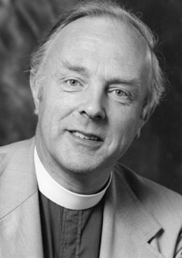
Revd. Michael Hubbard
One of the founders of the Counselling Centre from November 1967

Slide 13
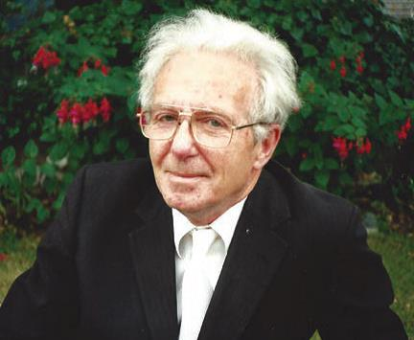
Revd. John Bradshaw
Co-founder of the Counselling Centre and its first Director

Slide 14
Revd. Dr. Harold Tonks
Director of the Centre, 1970 – 1986. Linked CLCC with The Uffculme Clinic and developed the training of volunteer counsellors in the centre beyond the in-house provision.

Slide 15
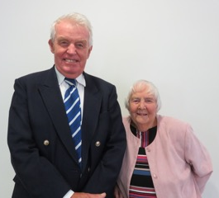
Bob and Margaret Cross (as they are today)
Two of the very first cohort of volunteer counsellors at the Counselling Centre

Slide 16
Joan White
Counselling volunteer in the 1970’s from Carrs Lane Church

Slide 17
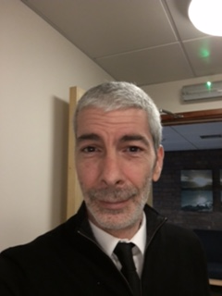
Current manager
Robin Yapp, Chartered MCIPD:
Counselling Centre Manager from May 2016 to the present day

Slide 18
Carrs Lane Chapel
c. 1963

Slide 19
Carl Rogers’ Person Centred Approach is our core strength underpinning our counselling service
Carl Rogers, an American psychologist, believed that personality formed as a result of our strivings to reach our full human potential.
According to Rogers, there are six conditions necessary to enable real change. These are:
There is psychological contact between the client and the counsellor
The client is emotionally upset, in a state of incongruence
The counsellor is genuine and aware of their own feelings (congruent)
(continued)

Slide 20
Carl Rogers’ six conditions necessary to enable real change (continued)
The counsellor has unconditional positive regard for the client
The counsellor has empathic understanding of the client and their internal frame of reference, and looks to communicate this experience with the client
The client recognises that the counsellor has unconditional positive regard for them and an understanding of their difficulties

Slide 21
Out of these, the following three are known as the 'core' or 'active' conditions:
Congruence - the counsellor must be completely genuine
Unconditional positive regard - the counsellor must be non-judgemental and valuing of the client
Empathy - the counsellor must strive to understand the client's experience

Slide 22
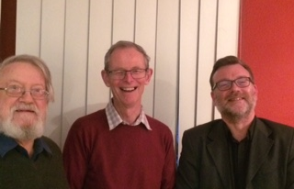
Retirement Presentation January 2017
Andrew Veitch (centre) retired as Chairman of the Carrs Lane Counselling Centre Board Of Trustees in January 2017, after serving on the board for 17 years.
(Left: Donald Payne; Right: Revd. Dr. Neil Johnson)

Slide 23
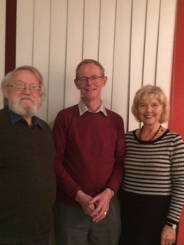
Another photo from the retirement party for Andrew Veitch
This time, photographed with Donald Payne and Elizabeth Cummings

Slide 24
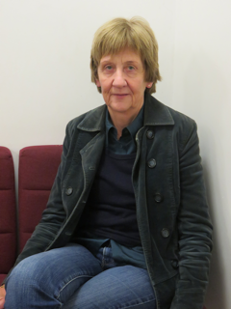
Anne Harris – Trustee and Volunteer Clinical Supervisor
Anne has been a long serving member of the Carrs Lane Counselling Centre in the role of Volunteer Clinical Supervisor. Over the years she has supported many volunteer counsellors, supervisors, trainers, management committee members and the Trustee Board.
She has taken endless minutes of meetings and dedicated a lot of personal time away from the centre carrying out this process. We appreciate all our volunteers and staff but Anne has held the ship together through the rocky times as well as the better times.
It is people like Anne who commit themselves and deliver whenever they are needed who help to make the difference.
A very big thank you to Anne.

Slide 25
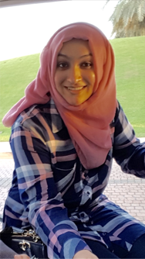
Volunteer Experience
My name is Fatema and I am a Trainee Counsellor at Carrs Lane Counselling Centre.
I am currently studying an Integrative Counselling course at the University of Leicester.

Slide 26
Fatema’s experience
Why counselling, you ask?
I was born in Tanzania, raised in the USA with my family origins coming from India. I have been very lucky to experience all these rich cultures; however I found talking therapy to be a massive taboo in most of my surroundings. This motivated me to gain understanding on how to bring about change in my cultures and community.

Slide 27
What have I gained? Training at Carrs Lane Counselling centre has been brilliant in equipping me with key skills and knowledge in this field. My experience has enabled me to improve my strengths and challenge my weaknesses. I feel that the manager and other trainers continuously work hard to provide support and valuable feedback. This, along with having a family of fellow counsellors at the centre, has been an important and unique part of my journey as well. It's an exceptionally diverse atmosphere which is a pleasure to be part of.
Fatema’s experience…

Slide 28
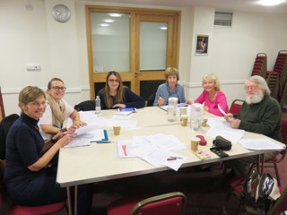
Carrs lane Counselling Centre Board of Trustees meeting October 2017
Left to right:
Caroline Homan,
Catherine O’Reilly,
Ami Kalam,
Anne Harris,
Liz Cummings and
Donald Payne

Slide 29
Celebrating 50 years!
If the Elders of Carrs Lane Church had not recognised the need of the local people and for them to have a safe place to come to, then there would not have been a counselling centre established in 1967. As Trustees of the Counselling Centre we wish to thank all our elders, funders, volunteer counsellors, administrative volunteers, supervisors, trainers, managers, trustees and service users, thank you!

Slide 30
Celebrating 50 years!
This centre is a valuable resource for the people in this area and provides a valuable service. But we are only sustainable through the sheer dedication of the volunteers who are committed to Carrs Lane Counselling Centre. Over the years we have volunteers from all walks of life and there has been some who have stayed for a short while, others who have committed tens of years of service and some who left and then returned.

Slide 31
Does counselling at Carrs Lane Counselling Centre make a real difference to people’s lives? We think so, but our clients say it best…

Slide 32
Client Comments:
If it were not for the support I received at Carrs Lane,
I’m not sure if I would be alive today.
2013

Slide 33
Client Comments:
When my family began to fall apart I really thought we could have worked it out and save our marriage. Unfortunately this was not to be. My self esteem was very low, lost confidence and depressing feeling all of the time wasn’t productive for my son. My counsellor worked through all my issues and has brought me to where I am today, back to my friendly, bubbly, confident self which has been noticed by all. I can wholeheartedly recommend Carrs Lane Counselling service to anyone who feels they fell down and couldn’t get back up again! I did! Thank you very much. I can’t tell you what it means to be ‘me’ again.
2013

Slide 34
Client Comments:
I am glad to have the opportunity to express my gratitude to (the counsellor) and for Carrs Lane. I arrived in Birmingham feeling that the rug had been pulled from under my feet and through my sessions have come to realise that though the rug was yanked away, there was still solid ground beneath it.
I have moved from a place of fear and confusion to a new place of confidence in my ‘new normal’. The last few years have been painfully transformational and this counselling experience has helped me to see and embrace the transformation. This has been a safe place to express myself and see that I can trust again.
2014

Slide 35
Client Comments:
My thanks to (the counsellor) who has helped me to return to being myself as my family remember me. I arrived here feeling that I was overwhelmed by life and now feel that I can deal with the world again.
2014
When I started this process six months ago I was in a difficult place. It’s been a challenging but extremely positive time, looking deeply at my worries, my past and my present circumstances. I understand far more about myself due to the work I have done with my counsellor. I am now in a good position to move on successfully with my life and make the most of what I have. Thanks to all at Carrs Lane. It’s been great!
2016

Slide 36
Client Comments:
When I started my counselling I thought I would not make it to week 2 as I thought it was a waste of time… I was wrong. (My counsellor) was very helpful in allowing me to open up and talk about my past. Being able to talk about everything in a safe and calm environment was so good. I feel I have found myself again. Thank you for listening and supporting me...
2016
This is the best thing I’ve done - it’s changed my life for the better!
2016

Slide 37
Client Comments:
My counselling with (my counsellor) has turned my life around. It’s my last session today - she has helped me work through no end of issues, which I will be eternally grateful for. At the start six months ago I was a complete wreck emotionally and physically, but (my counsellor) has supported and walked with me through some extremely tough stuff, and I now feel I can live my life instead of just existing I will miss our sessions but with my counsellor’s help and encouragement and many tissues for my endless tears, I think I can now walk on my own. So, I’d like to say a huge THANK YOU both to (my counsellor) and Carrs Lane Counselling Centre for providing such a great source of help and support for people like me, without which we would be lost. It is one of the best experiences of my life so far.
2016

Slide 38
Client Comments:
I went through a truly devastating series of life events in 2015, including the break up of my relationship and the death of my father. The conversations I have had with (my counsellor) have been extremely valuable to me as they have helped me put life’s events into perspective and to overcome the shock I felt during that time.
The patience and neutrality of a counsellor allowed me to put my thoughts in order and to air my deepest fears about my own weaknesses and sense of failure. (My counsellor) made me realise my feelings and reactions were normal and not weak and that I would be able to come to terms with them and find peace of mind in time.
I would strongly recommend some kind of counselling or talking therapy to anyone I know who was feeling as low as I was. I am extremely grateful to Carrs Lane Counselling Centre and hope that such a valuable resource is never lost. Such help is hard to find as it is and it truly makes a huge difference. Thank you very much.
2017

Slide 39
We hope you enjoyed our presentation.

